Slide 1
UD5: INFERENCE
Part 1: Distributions in sampling
Part 2: Inference about one population
Comparison of 2 populations
Part 3: ANOVA (Analysis of Variance)
Design of experiments
Part 4: Regression
1

Slide 2

UD 5 part 4
REGRESSION
2

Slide 3
TWO-DIMENSIONAL RANDOM VARIABLES
WHEN TWO RANDOM NUMERIC CHARACTERISTICS ARE OBSERVED FROM EACH INDIVIDUAL, WE HAVE A TWO-DIMENSIONAL RANDOM VARIABLE.
E.g. In the population of students, we observe the height (cm) and weight (kgs) of each student.
For the control of energy consumption in a factory, we record every day the CONSUMPTION and the daily temperature (ºC).
3

Slide 4
Study of 2 QUALITATIVE VARIABLES:
  BY MEANS OF A CONTINGENCY TABLE
REPEAT
YES
NO
Row
  Marginal frequency of gender
  Marginal frequency of repeat
  Relative frequency of gender conditined to repeat
  Relative frequency of repeat conditioned to gender
GENDER
1
2
Total
MALE
5
41
46
1
83.3
10.9
63.1
89.1
64.8
FEMALE
1
24
25
2
16.7
4.0
36.9
96.0
35.2
COLUMN
6
65
71
TOTAL
8.5
91.5
Marginal frequencies:
  Frequency of each value of one variable without taking into account the other
Relative conditional frequencies:
  Relative frequency of the value of one variable in relation to each value of the other
4

Slide 5
Study of 2 QUANTITATIVE VARIABLES:
  1) BY MEANS OF A CONTINGENCY TABLE AFTER GROUPING THE DATA IN INTERVALS.
2) Scatter plot: graphical representation of the relationship.
3) Covariance and linear correlation: quantifies the “degree” of linear relationship between x , y
4) Simple regression: models the relationship for predictive purposes.
5

Slide 6
HEIGHT
145
155
165
175
185
Row
155
165
175
185
195
Total
WEIGHT
40 55
9
17
0
0
0
26
75.0
44.7
.0
.0
.0
20.0
55 70
3
18
31
5
0
57
25.0
47.4
53.4
29.4
.0
43.8
70 85
0
3
24
12
3
42
.0
7.9
41.4
70.6
60.0
32.3
85 99
0
0
3
0
2
5
.0
.0
5.2
.0
40.0
3.8
Column
12
38
58
17
5
130
Total
9.2
29.2
44.6
13.1
3.8
100
Marginal frequency of weight
Marginal frequency of height
Relative frequency of weight conditioned to height
PROBLEM: SOME INFORMATION IS LOST IN THE TABULATION
6

Slide 7
WEIGHT (Kg)
Condicional distributions of weight with respect of height
90
Marginal distribution of weight
80
70
60
50
HEIGHT (cm)
145-155
155-165
165-175
175-185
185-195
HEIGHT Nº of STANDARD
cases MEAN DEVIATION MIN. MAXIMUM
----------------------------------------------------------------------------------------------------
145-155 12 53.0000 6.39602 45 65
155-165 38 57.7895 7.45856 46 80
165-175 53 70.8793 7.61134 56 90
175-185 17 73.4118 4.71777 66 84
185-195 5 84.0000 4.18330 77 88
-----------------------------------------------------------------------------------------------------
7

Slide 8
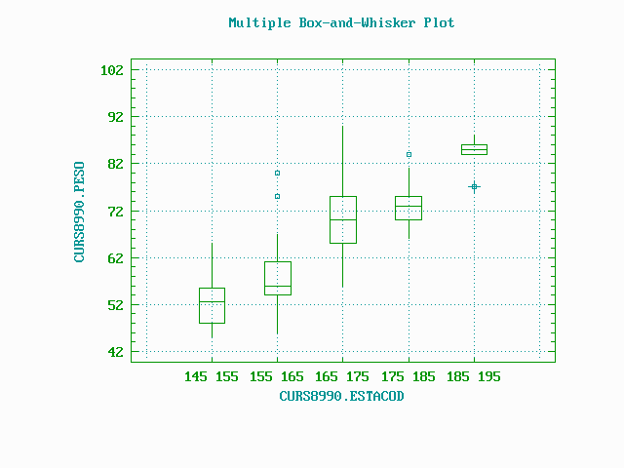
PROBLEM: SOME INFORMATION IS LOST IN THE TABULATION
8

Slide 9

SCATTERPLOT
Plot of WEIGHT versus HEIGHT
95
85
75
WEIGHT
65
55
45
150
160
170
180
190
200
HEIGHT
9
What colors corresponds to men and women ?

Slide 10
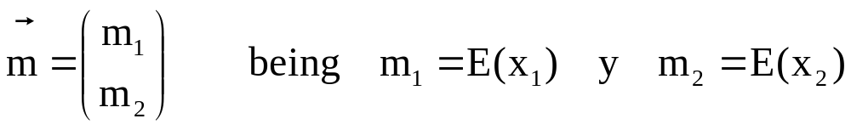
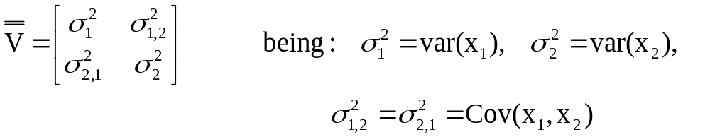
TWO-DIMENSIONAL NORMAL DISTRIBUTION
EXAMPLES:
- Speed of processor and time required to execute a calculation
- Room temperature and power consumption in heating
- Weight and height of a person
... are two components of a bivariate Normal distribution
Vector of averages
Matrix of variances - covariances
10

Slide 11
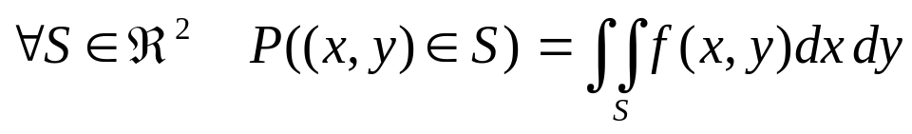
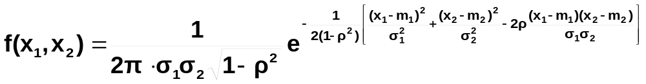
Two-dimensional density function: f (x, y)
The two components X₁ and X₂ of a bivariate random variable have a bivariate normal distribution if the joint density function is:
Being:
m₁ , σ₁² : mean and variance of the distribution of X₁
m₂ , σ₂² : mean and variance of the distribution of X₂
ρ : correlation coefficient between X₁ and X₂
11

Slide 12
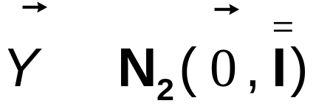
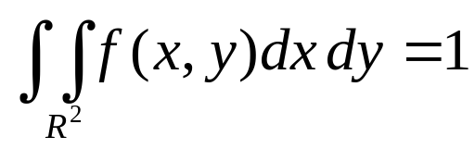
∼
ISODENSITY CURVES
TWO-DIMENS. NORMAL DISTRIBUTION
Bivariate Normal Surface
Bivariate Normal Surface
3
2
0.16
1
0.12
Y
0
Z
0.08
-1
0.04
3
2
-2
1
0
0
-1
-3
-3
-2
Y
-2
-1
0
-3
1
2
3
-3
-2
-1
0
1
2
3
X
X
Volume under the surface = 1
12
Probabilities are obtained integrating

Slide 13
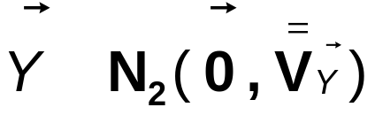
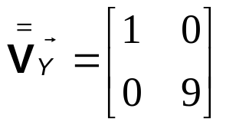
∼
ISODENSITY CURVES
TWO-DIMENS. NORMAL DISTRIBUTION
Bivariate Normal Surface
Bivariate Normal Surface
25
(X 0.001)
15
18
15
5
12
Y
Z
9
-5
6
25
3
15
-15
5
0
-5
-7
-15
-4
-1
-25
Y
-25
2
5
8
-7
-4
-1
2
5
8
X
X
13

Slide 14
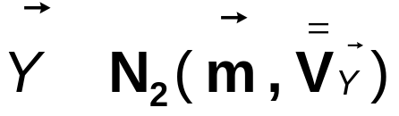
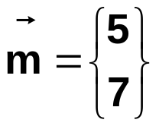
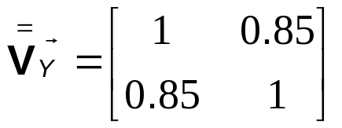
∼
TWO-DIMENS. NORMAL DISTRIBUTION
ISODENSITY CURVES
Bivariate Normal Surface
Bivariate Normal Surface
10
9
0.4
8
0.3
Y
7
Z
0.2
6
0.1
10
9
8
5
0
7
6
2
5
Y
4
3
4
5
4
6
7
8
2
3
4
5
6
7
8
X
X
14

Slide 15
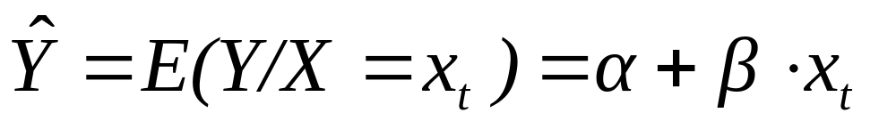
SIMPLE REGRESSION: THEORETICAL MODEL
Y
Conditional distributions
E(Y/X₁)=m₁
E(Y/X₂)=m₂
m_{Y}
E(Y/X₃)=m₃
Marginal distribution of Y
Regression line
X₁
X₂
X₃
X
15

Slide 16
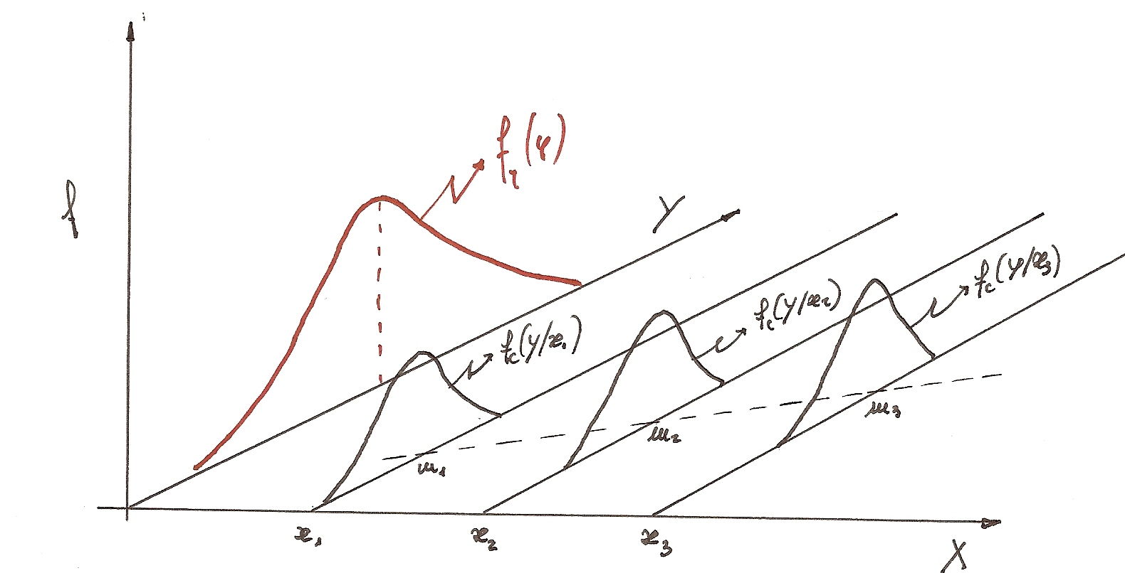
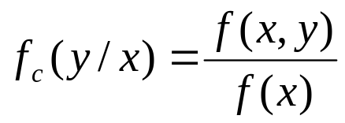
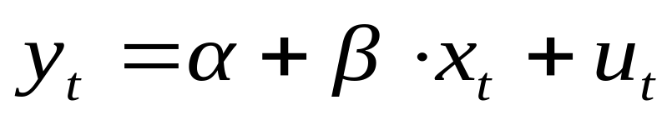
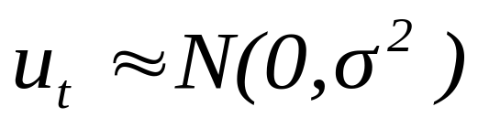
Conditional distribution y/x : distribution of y when x takes a particular value
Marginal distribution of y
Variance of residuals (“residual variance”)
Residuals:
(Variance of the conditional distribution =
= variance of residuals) < variance of Y
16

Slide 17
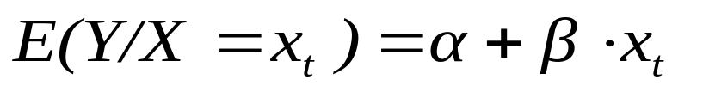
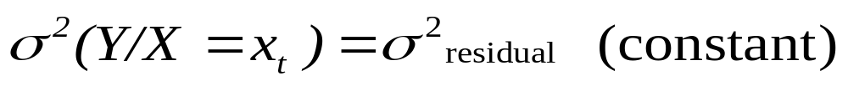
SIMPLE LINEAR REGRESSION
Y = f ( X )
THE CONDITIONAL DISTRIBUTION: Y / X=x_{t} is a random variable with parameters:
EXAMPLE:
Y DAILY GAS CONSUMPTION IN WINTER IN A FACTORY FOR HEATING
X TEMPERATURE OF EACH DAY (ºC)
What is α ?
AVERAGE CONSUMPTION WHEN Tª = 0º C
What is β ?
INCREASE OF Y (AVERAGE GAS CONSUMPTION) IF TEMPERATURE INCREASES 1ºC
Will β be positive or negative in this case?
17

Slide 18
POPULATION
SAMPLE
The linear relationship existing at the population level between the two quantitative components of a bivariate random variable (X,Y) is:
The linear relationship existing between the two quantitative components of a bivariate random variable, estimated from the sample, is:
E(Y) = a + b ·X
y_{j} = a + bx _{j}+ e _{j}
E(Y) = α + β ·X
Y
E(Y/X=x_{j}) = α + β x_{j}
residual
u_{j}
α = a
X_{j}
β = b
y_{j} = α + β·x _{j}+ u _{j}
residual
18

Slide 19
How can we quantify the degree of correlation between 2 variables?
Covariance
Plot of Consump. vs Temperature
Cov < 0
X=Xmean
Cov >0
500
400
300
Y= Ymean
Consump.
200
Cov >0
Cov <0
Y_{i} -Y_{mean} < 0
100
X_{i} -X_{mean} > 0
0
-3
1
5
9
13
17
21
Temperature
∑
−
−
(X
X
)(Y
Y
)
Cov
=
i
i
(X,
Y)
N
−
1
19

Slide 20
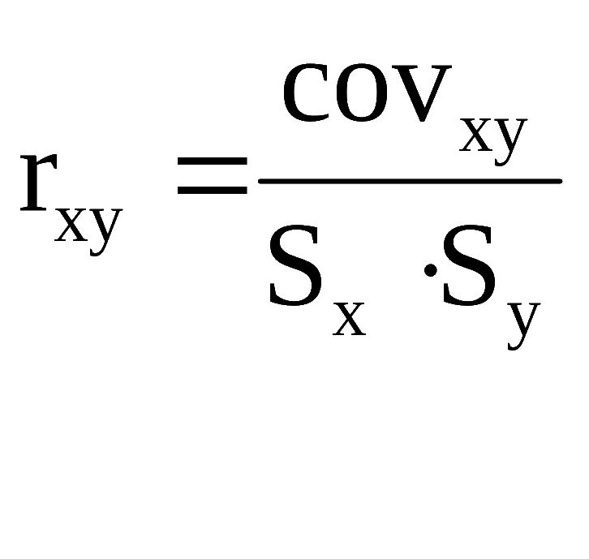
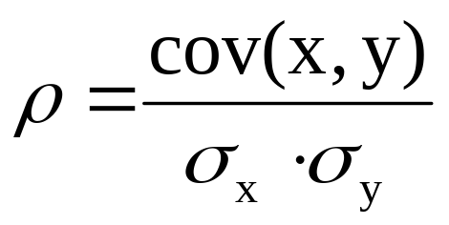
If covariance = -50, is the correlation between the 2 variables strong or weak?
Drawback: depends on the dimensions (scale) in which variables are measured.
CORRELATION CEFFICIENT
Advantage: is non-dimensional
-1 < r_{xy} < 1
20

Slide 21
σ²_{x}
Matrix of Variances - covariances
Matrix of covariances
cov (x₁, x₁) cov (x₁, x₂)
var (x₁) cov (x₁, x₂)
cov (x₂, x₁) cov (x₂, x₂)
cov (x₁, x₂) var (x₂)
cov (x₁, x₁) cov (x₁, x₂) cov (x₁, x₃)
The matrix is symmetric !
cov (x₂, x₁) cov (x₂, x₂) cov (x₂, x₃)
cov (x₃, x₁) cov (x₃, x₂) cov (x₃, x₃)
Matrix of
correlations
r_{xx} r_{xy}
1 0,7404
r_{yx} r_{yy}
0,7404 1
21

Slide 22
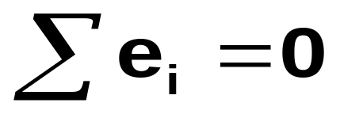
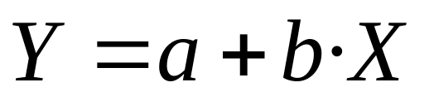
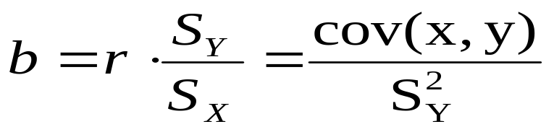
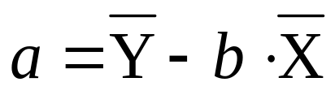
CALCULATION OF REGRESSION LINE
Y
e_{i}
minimize Σ e_{i}²
X
Y
e_{i}
22
X

Slide 23
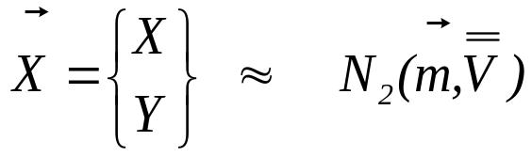
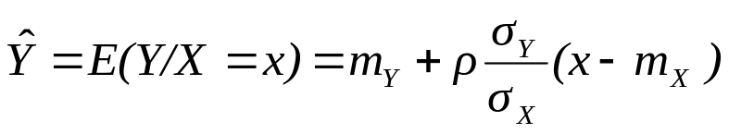
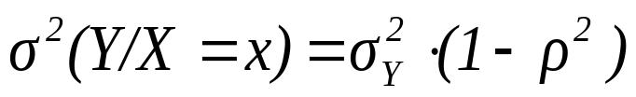
REGRESSION
Statistical tool used to establish a model (mathematical equation) able to predict values of a dependent variable Y as a function of one or more input variables (X₁,X₂, …,X_{j}).
Y = f(X) => simple regression
Y = f(X₁,X₂, …,X_{j}) => multiple regression (linear or non-linear)
If
Then the two marginal distributions are Normal
The conditional distribution of Y when X = x is Normal with:
Mean:
(regression line)
Variance:
(residual variance)
Does not depend on X (homoskedasticity)
23

Slide 24
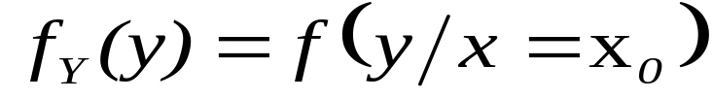
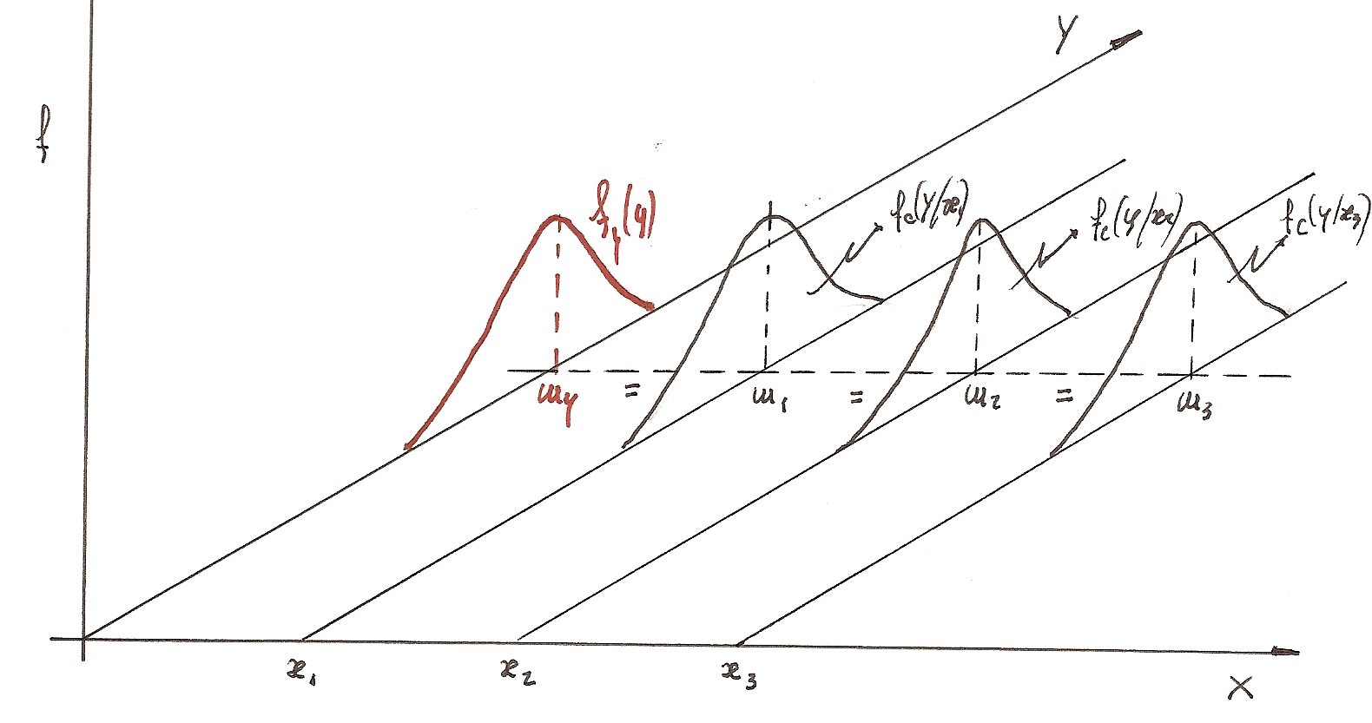
INDEPENDENCE OF 2 CONTINUOUS VARIABLES
Two components X, Y of a bivariate random variable are independent if the events (X≤x) and (Y≤y) are independent
EXAMPLE: Two variables are studied: the height of a student and the time required to arrive at university.
Are they correlated?
Are they independent?
INDEPENDENT:
The distribution of time will be the same for any height and the same for the marginal distribution
24
height

Slide 25
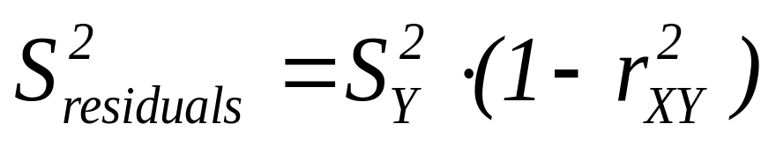
INTERPRETATION OF r²
Y/X=x_{o}
Y
Y
Y/X=x_{o}
x_{o}
X
x_{o}
X
r²=0 ; b=0 ; S²_{res} = S²_{y}
0 < r² < 1 ; S²_{res} < S²_{y}
X, Y are independent
r² : proportion of the variability of Y explained by variable X
In simple regression:
coefficient of determination (R²) = (correlation coefficient)² = r²
25

Slide 26
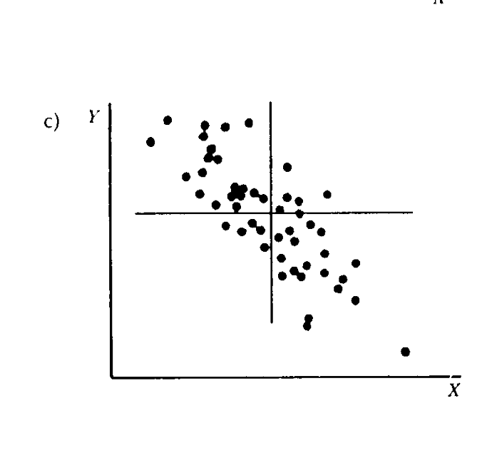
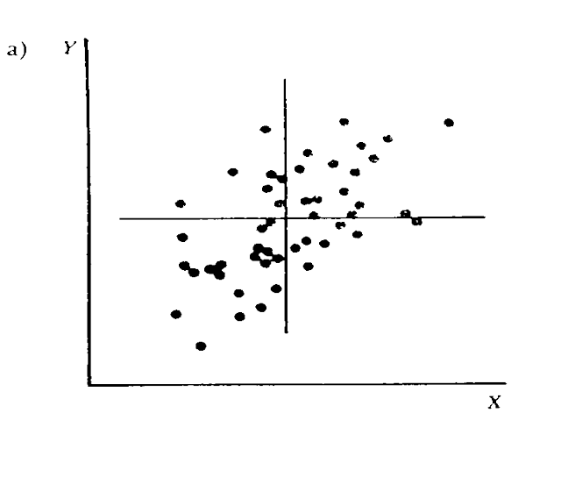
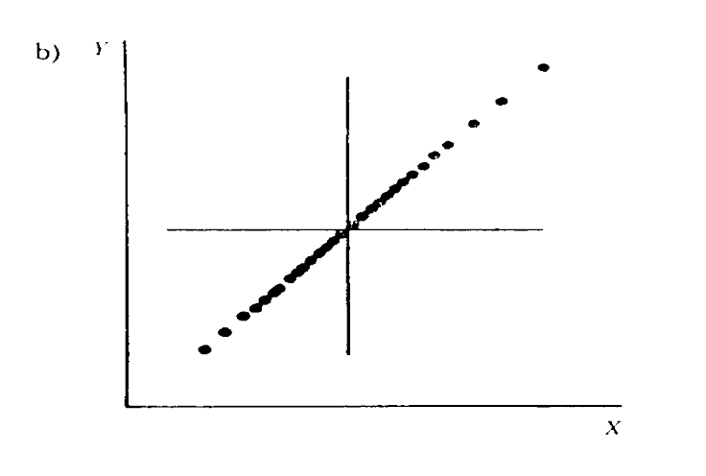
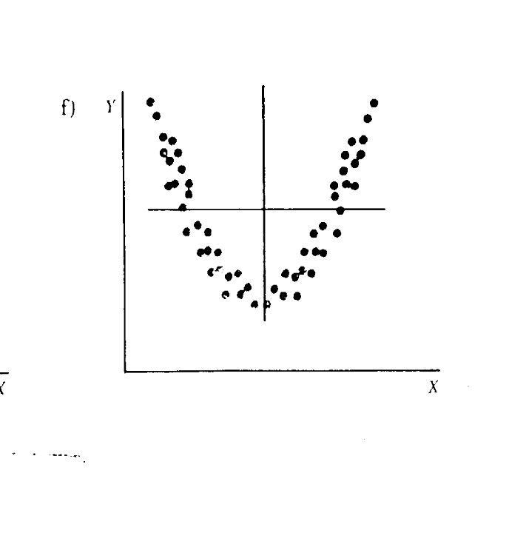
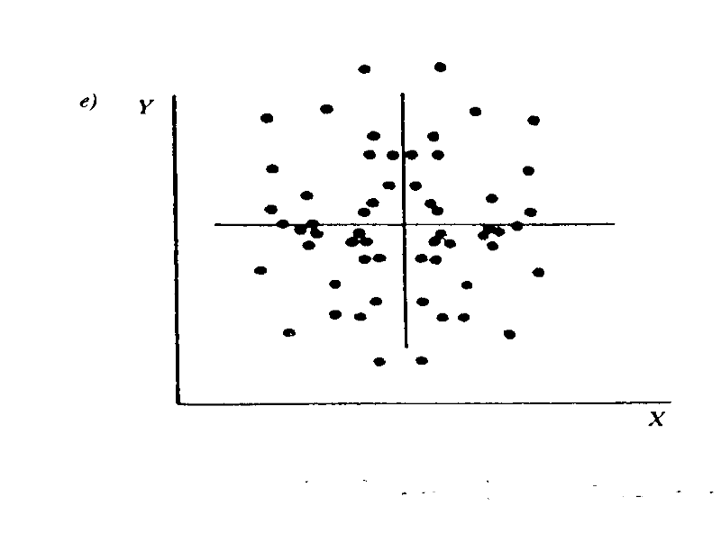
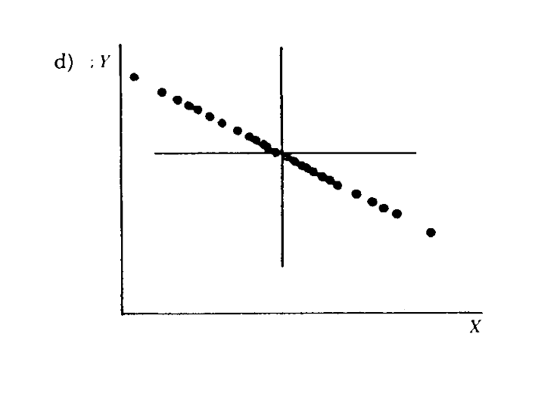
TYPES OF SCATTERPLOTS
INTERPRETATION OF REGRESSION MODELS
r>0
r=1
r<0
r=-1
r=0
r=0
26

Slide 27
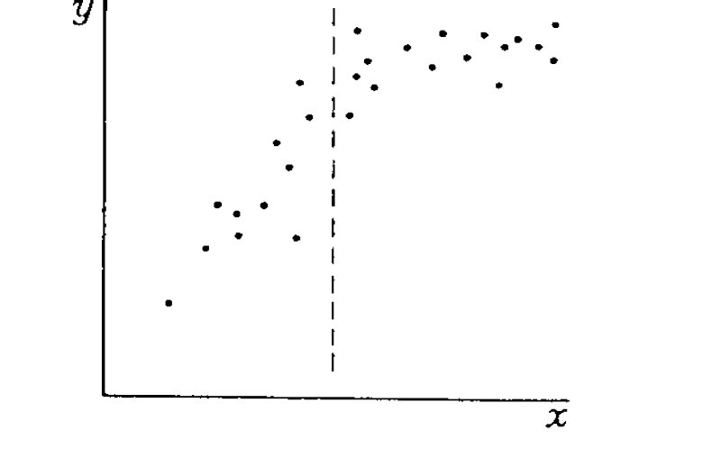
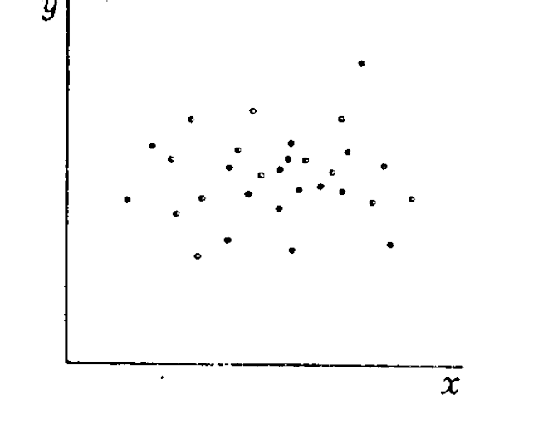
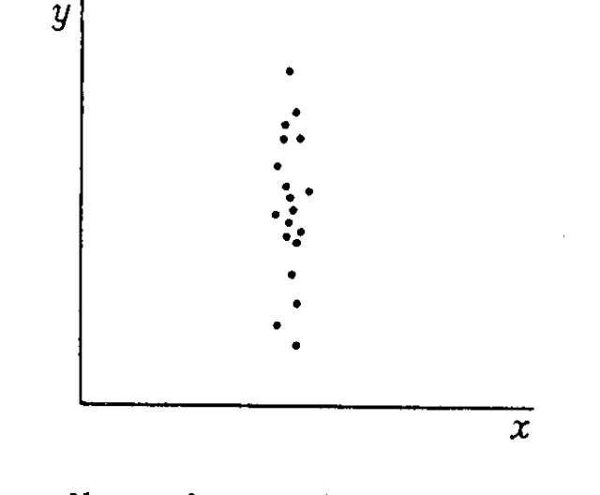
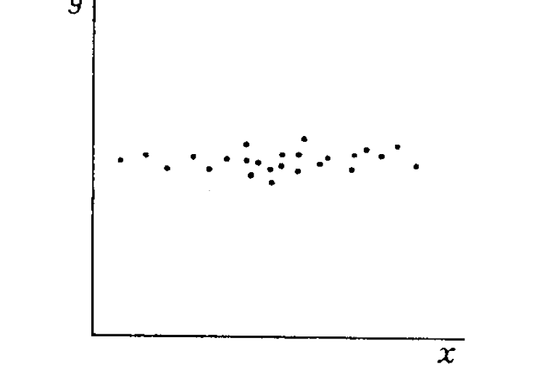
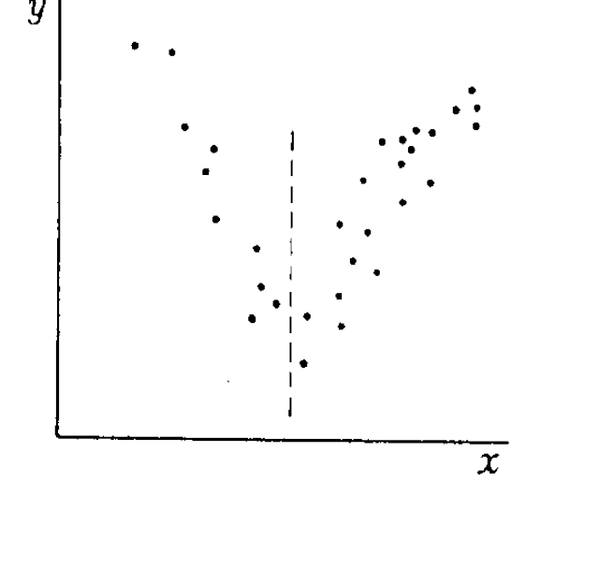
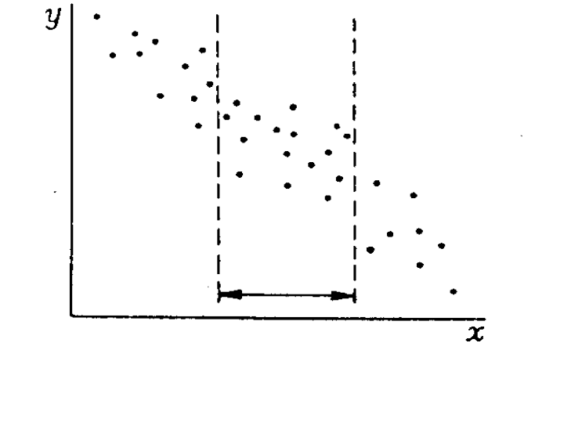
TYPES OF SCATTERPLOTS
r=0
r=0
r>0
r=0
r<0
27

Slide 28
EXAMPLE: The government wants to promote the use of computers among citizens.
INTERPRETATION OF RELATIONSHIPS BETWEEN 2 VARIABLES
- One study reveals that, in Spanish homes, the annual expenses in computers is positively correlated with the expenses in shoes.
- CONCLUSION: the government decides to promote the expenses in shoes (by lowering the prices) in order to incentivate the use of computers.
Expenses in shoes
Nº children/family, age, level of studies, family income...
Not causal relationship
Expenses in computers
Partial dependence
28

Slide 29
THE CORRELATION OBSERVED BETWEEN 2 VARIABLES DOES NOT IMPLY NECESSARILY A CAUSE-EFFECT RELATIONSHIP
VERY IMPORTANT RULE:
INTERPRETATION OF RELATIONSHIPS
One-way causal dependence
CAUSE EFFECT
Room temperature
Power consumption for heating
Amount of rain
Amount of water in reservoirs
Speed of computer processor
Time required to carry out a computational operation
29

Slide 30
INTERPRETATION OF RELATIONSHIPS
Partial dependence with one or more variables:
CAUSE EFFECT
Genetic characteristics
Height and weight
Family income
Expenses in shoes of families
Attendance of theory classes
Final score in the exam
Nº hours of study of Statistics
Final score in the exam
Interdependence between both variables:
Supply and demand of a product
Levels of sales and expenses in advertising
Age of husband and wife in a couple
30

Slide 31

RESIDUALS
Conditional distribution Y / X = X₂
Y ( consumption day t)
Y₁
U₁= Y₁ -
E ( Y / X = X₁ )
Conditional distribution Y / X = X₃
E ( Y / X = X₂ )
Conditional distributionY / X = X₁
E ( Y / X = X₃ )
REGRESSION LINE
MARGINAL DISTRIBUTION OF Y
X
X₁
X₂
X₃
31

Slide 32
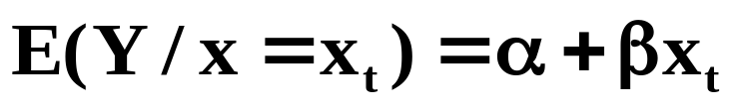
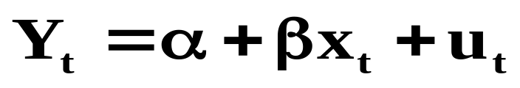
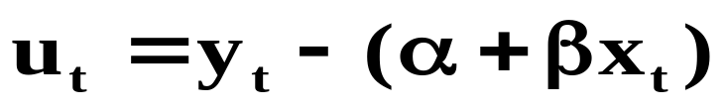
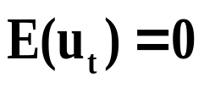
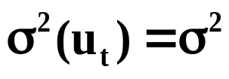
Residual u_{t} = y_{observed} - y_{predicted}
(example of gas consumption vs Tª):
u_{t} = consumption observed at day t (y_{t}) MINUS average consumption estimated when temperature = x_{t}
· IT IS ASSUMED THAT u_{t} :
· ARE NORMALLY DISTRIBUTED
· ARE INDEPENDENT BETWEEN THEM
U_{t} COLLECTS THE EFFECT OF ALL REMAINING FACTORS (NOT INCLUDED IN THE MODEL) OVER GAS COMSUPTION IN A GIVEN DAY t.
32

Slide 33
ANALYSIS OF RESIDUALS
Outliers: are identified with a Normal Probability Plot
Lack of normality in the data: it can be studied by plotting residuals in a Normal Probability Plot.
Lack of linearity in the relationship between E(Y) and X: it can be studied by plotting e_{i} as a function of X_{i}
e
e
0
0
X
X
Linear relationship
Quadratic relationship
33

Slide 34
  ANALYSIS WITH STATGRAPHICS
  Data of weight (kg) and height (cm) were collected from students registered in this university certain year.
  Data were analyzed by means of a regression analysis using Statgraphics.
a) Weight = a + b · height
What is the interpretation of a?
b) Weight = a + b · (height - 150)
What is the interpretation of a?
What model is more convenient for an easier interpretation of the regression coefficients?
34

Slide 35
  Regression Analysis - Linear Model: Y = a + b X
  Dependent Variable: WEIGHT
  Independent Variable: HEIGHT - 150
  Parameter Estimate Standard error T statistic P-value
  Intercept 46,343 1,7078 27,1355 0,0000
  Slope 0,869 0,0695 12,5124 0,0000
  Analysis of Variance
  Source Sum of Squares Df Mean Square F-Ratio P-Value
  Model 8094,44 1 8094,44 156,56 0,0000
  Residual 6669,58 129 51,70
  Total 14764,00 130
Correlation Coeficient 0,7404
R-squared: 54,83 %
Standard Error of Est. =
a) What is the standard deviation of weight for those students with a height of 175 cm?
b) Obtain for the 95% of cases, the weight of students with a height of 175 cm.
35

